Slide 1
Quantum queries on permutations
Taisia Mischenko-Slatenkova,
Agnis Skuskovniks, Alina Vasilieva, Ruslans Tarasovs and Rusins Freivalds
“COMPUTER SCIENCE APPLICATIONS
AND ITS RELATIONS TO QUANTUM PHYSICS”,
project of the European Social Fund
Nr. 2009/0216/1DP/1.1.1.2.0/09/APIA/VIAA/044
INVESTING IN YOUR FUTURE

Slide 2
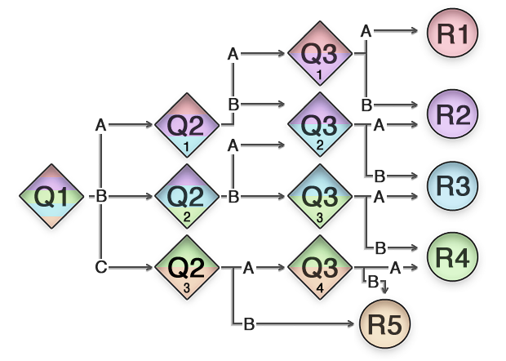
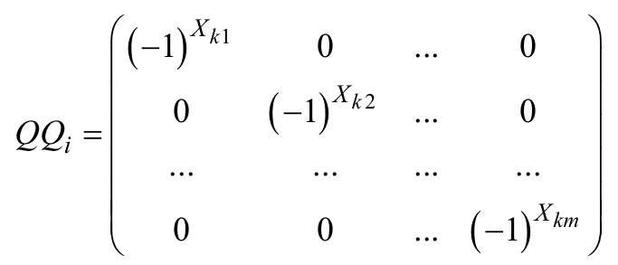
Introduction
Query algorithms
Decision trees
Quantum Querry algorithms
Querry algorithm complexity
Number of queries performed
Exact quantum query algorithms
Accepting prbability is always 0 or 1
Promise for Quantum algorithms
Domain of correctness of the algoritm is explicitly restricted
Decision tree from:http://manuals.matrix.squizsuite.net/other-cms-assets/chapters/decision-tree

Slide 3
Studied Functions
Problem domain – permutations!
For example:
5 symbol permutation 43210 has function variables:
Functions value
Determines permutation properties
For example:
3-permutation is even (opposite to odd)
There is a 1 query Quantum algorithm for this problem
Classical query algorithm needs 2 queries
This can be generalize to: 2m-permutation QQ=m; [2m+1 -> QQ=m+1]

Slide 4
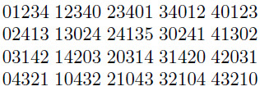
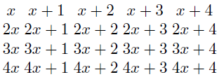
Our results for 5-permutations
A group GR with operation “multiplication of permutations”
GR is not a commutative and is not cyclic
Function:
Membership in the group GR of
5-permutation
Result: Solution with 2 queries
4 Deterministic queries are needed classically

Slide 5
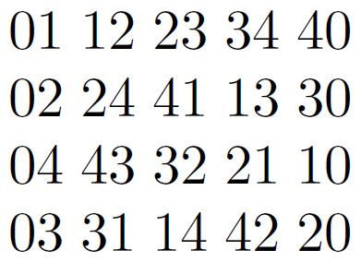
Structure the query/answer pairs in a table
Ask all 20 question pairs in parallel
If result is “far away” (Distance={2,3}) then multiply to -1
If result is “close” (Distance={1,2}) then multiply to +1
Example: 03241
Example: 20314
If all the signs are equal – belongs to GR
If signs are different then
Half the signs are + and half –
Does not belong to GR

