Slide 1
An Ontology-Driven Fuzzy Workflow System
University of Hradec Králové Faculty of Informatics and Management
Enhancing flexibility and adaptability of workflow management systems by their integration with fuzzy ontologies
Václav Slavíček

Slide 2
Goals
1. Introduction
Integration of the following components:
Ordinary Information System in an organization
Workflow Management System
Knowledge Repository
Vague nature of information in the above systems
Emphasis on the flexibility
Notes:
Technologies in use: Business Process Management, Workflow Management
Object-Oriented Programming
Web Ontology Language (OWL)
Fuzzy Sets
Relational Databases

Slide 3
Examples of Business Process notation
2. BPM and WfM
Source: Tscheschner, W. Transformation from EPC to BPMN. Hasso-Plattner-Institut. [Online] 2008. [Cited: 14 1 2012.] http://bpt.hpi.uni-potsdam.de/pub/Public/OryxResearch/TransformEPC2BPMN.pdf.
EPC
BPMN
Notes:
Business Process Management Notation (BPMN) provided by OMG (3),
Business Process Execution Language (BPEL) by global consortium OASIS,
Integrated DEFinition method for Process Description Capture (IDEF3) by U.S. Department of Defence (4),
description of business process is also possible by means of Petri Nets (5).
Note: U BPM zápisu je lhostejné, zda jej bude provádět/podporovat IT, nebo zda bude vykonáván manuálně.

Slide 4
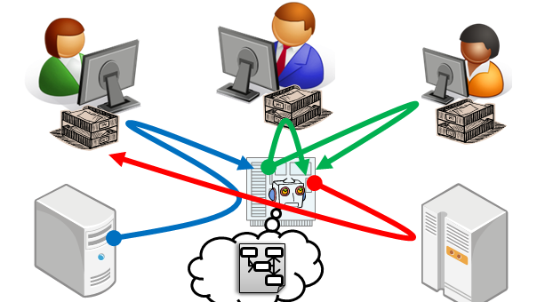
Workflow management system
2. BPM and WfM
Workflow is an element of business process automation in which are documents, information and tasks handed from one process participant to another, according to a set of procedural rules, to achieve a given goal.
Workflow management system provides procedural automation of a business process by management of the sequence of work activities and the invocation of appropriate human and/or IT resources
Source: WfMC. Workflow Management Coalition Terminology & Glossary. [Online] 3.0, 1999. [Cited: 4 12 2011.] http://www.wfmc.org/standards/docs/TC-1011_term_glossary_v3.pdf. WFMC-TC-1011.

Slide 5
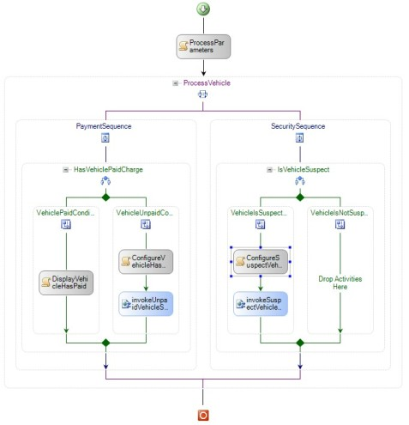
Example of workflow notation
2. BPM and WfM
…a guideline for the information system on how a business process should be supported

Slide 6
Background and related work
3. Background
Flexible and adaptable workflows
Utilization of organizational knowledge in workfow management
Work with vagueness
in knowledge representation
in workflow management
Notes:
Existujících směrů bádání ve workflow managmentu je samozřejmě víc, např. formalizace popisu workflow, evaluace a porovnávání existujících komerčních nástrojů, scientific worklfow, workflow execution log analysis,…

Slide 7
Flexible and adaptable workflows
3. Background
Example are knowledge-intensive processes:
unstructured
unpredictable
Flexibility in workflows … ability to divert from the predefined scenario
Flexibility by selection – ad hoc diversion from the scenario
Flexibility by adaptation (adaptability) – by altering the scenario itself - “workflow evolution”
Notes:
Stochastic nature

Slide 8
Ontology data model
3. Background
Formalized description of knowledge within a specific domain
Knowledge inference by means of a reasoner
Example: Web Ontology Language (OWL)
Based on Description Logic
Collection of triplets {subject, predicate, object}
Several notations: RDF/XML, OWL/XML, Manchester, Turtle.

Slide 9
Integration
3. Background
Object-oriented model – commonly used throughout information systems
Ontology model - knowledge repository
Workflow model that supports long-running business processes
Notes:
Direct, indirect, hybrid OOP-ontology integration

Slide 10
Vagueness in the workflow management
3. Background
Weak workflows
Progressive model
Retroactive workflows
Dynamic workflows
Fuzzy workflows

Slide 11
Fuzzy sets and fuzzy logic
3. Background
Classic; crisp logic
0 .. false
1 .. true
Fuzzy logic
<0;1>
Notes:
Handles vague and uncertain expressions like “rather” or “almost”
Uses linguistic variables and terms
Resembles human thinking
Facilitates design of complex systems
Zaden, Goedel, Lukasiewicz, Product...
implication (Kleene-Dienes, Zadeh, Lukasiewicz, Mandami),
Results for borderline values 0, 1 same as in the crisp logic
+implikace

Slide 12
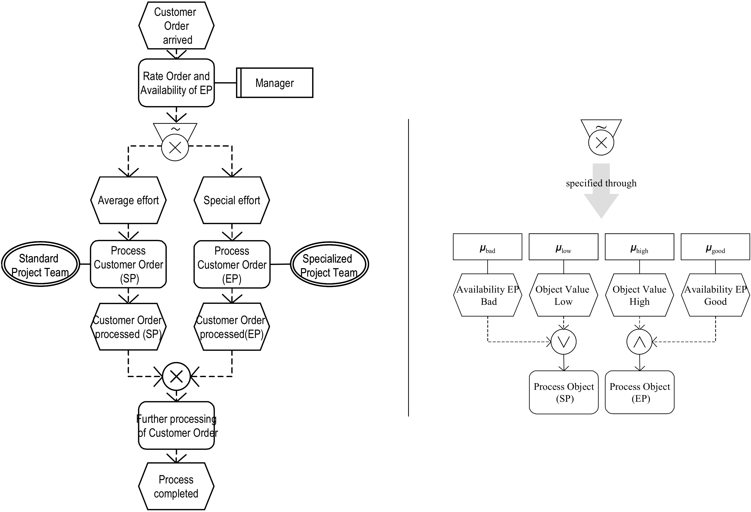
Fuzzy logic in workflows
3. Background
Example: Fuzzy BPM – an EPC extension
Source: Adam, O., Thomas, O., Gunnar, M. Fuzzy Workflows- Enhancing Workflow Management with Vagueness. German Research Center for Artificial Intelligence (DFKI). [Online] 2003. [Cited: 14 10 2011.] http://www.tk.uni-linz.ac.at/EUROINFORMS2003_Workflow/rc30_1.pdf.
Notes:
Event-driven process chain, a concept in Business Process Modeling
Zápis pravidel:
IF "object value" = low OR "EP availability" = bad THEN SP processes customer order
IF "object value" = high AND "EP availability" = good THEN EP processes customer order

Slide 13
Fuzzy logic in ontologies
3. Background
Theoretical framework
fuzzy SHOIN^{(D)}
Implementation of vagueness in ontology
FuzzyOWL2,
Implementation in reasoner
FuzzyDL,
DeLorean
FOWL
Notes:
Fuzzy Shoin(D): fuzzy modifiers, fuzzy axioms, fuzzy RBoxes, fuzzy TBoxes, and fuzzy Aboxes
FuzzyDL and DeLorean (DEscription LOgic REasoner with vAgueNess). The former reasoner represents queries as a linear optimization problem, the latter one computes a rough equivalent non-fuzzy representation from a fuzzy source assuming a finite chain of degrees of truth.

Slide 14
Goals
4. Goals
Methodology for designing an ontology-based fuzzy workflow system, with the following properties:
Goal-driven rather than process-driven
Flexible
Transparent
Capitalizes on the organizational knowledge
Works with vague information
Respects the nature of human process participants
Contributes to the workflow model evolution
Easy to implement in real life

Slide 15
Goals
4. Goals
Building a functional prototype, with a possible re-use of existing components
Evaluation of the viability

Slide 16
Basic Schema
5. Results
Extension of the components with fuzzy logic
Integration

Slide 17
Fuzzy Framework
5. Results
Component for the fuzzy sets support
Works with existing math expression parser → easy to integrate into
an existing information system
an existing workflow management system
Support of both discrete and continuous sets
Membership function modelled as a set of polynomial functions on particular disjunct intervals within the domain of definition

Slide 18
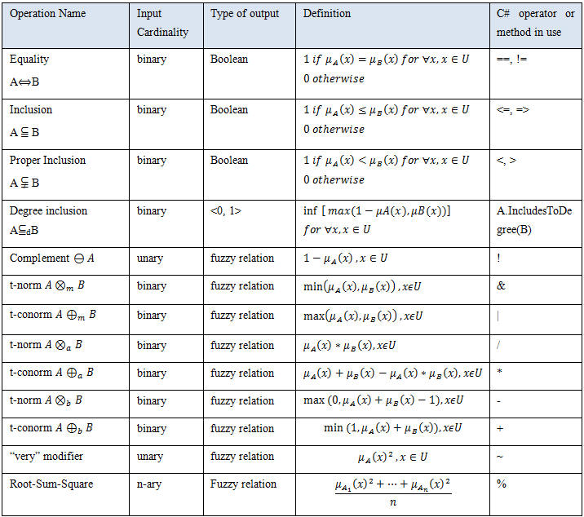
Fuzzy Framework - operations
5. Results
Operations on fuzzy sets by means of standard C#/VB.NET operators
Easy implementation of fuzzy logic into Windows Workflow Foundation designer.
List of opeations on fuzzy sets supported by Fuzzy Framework

Slide 19
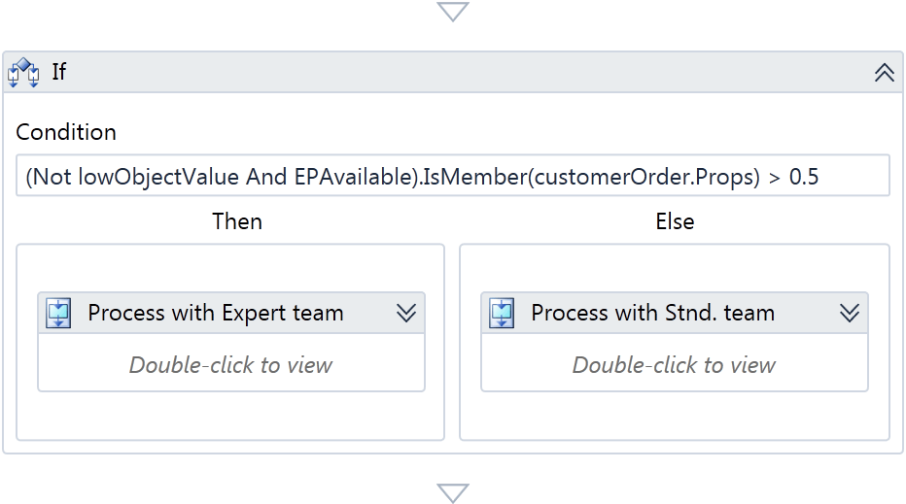
FuzzyFramework – example of use
5. Results
Definition of an if-else workflow activity
Workflow continues either one or the other way, based on the fuzzy condition evaluation

Slide 20
Fuzzy Framework – example of use
5. Results
Graphical output
Hierarchical decomposition of a fuzzy relation

Slide 21
Design of custom workflow activities
5. Results
Example: Fuzzy task distribution list
Particular tasks assigned to an operator are rich-formatted
Corresponds to the proximity between an ideal and the available operator
Possibility to specify a threshold for maximum proximity
Notes:
Human-centric workflow activities
Information flow from a human to WfMS – this involves collection of input parameters, processing of human decisions, authorizing approvals by accountable persons, etc.
Information flow from WfMS to humans – i.e. distribution of tasks being assigned to responsible persons, message announcement to persons to be informed.

Slide 22
Fuzzy Ontology Framework – integration of IS with a fuzzy ontology
5. Results
Schema of the FuzzyOntologyFramework component

Slide 23
Fuzzy Ontology Framework – integration with a fuzzy ontology
5. Results
Hybrid (both direct and indirect) integration of object-oriented and fuzzy ontology model
The goal is to answer the following types of questions:
individual-concept affiliation
concept subsumption

Slide 24
Feedback from the workflow to the ontology
5. Results
Logging of processed workflow instances
Transfer of statistics to the main relational DB
Inference of implicit knowledge in the ontology
Alteration workflow execution in the future
Example:
In an insurance company, the assessor is logged for all processed insurance claims
For each employee, they keep the number of processed claims in a statistics.
The ontology contains the following concept: InsuranceClaimExpert as Employee and numberOfProcessedClaims some highNumberOfClaims
New claims are assigned to employees with the affiliation to concept InsuranceClaimExpert based on an ontology reasoning.

Slide 25
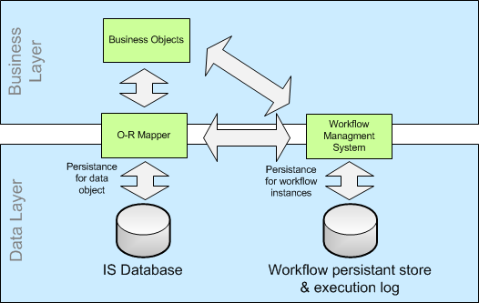
Feedback from the workflow to the ontology
5. Results
Feedback from the workflow execution log to the relational database of the IS, which is in turn involved in the ontology reasoning.
Notes:
Information flow, ontology update

Slide 26
Questions
?

