Slide 1
SimCo – Hybrid Simulator for Testing of Component Based Applications
Richard Lipka, Tomáš Potužák, Přemek Brada, Pavel Herout
Department of Computer Science and Engineering
Faculty of Applied Sciences
University of West Bohemia, Pilsen, Czech Republic

Slide 2
Agenda
Motivation and goals
Principles of simulation testing
SimCo structure
Experiments and case study
Future work

Slide 3
Motivation and goals
Components as standard units
Stored in repository, used to build an application
Described by
Function
Extra-functional properties
Testing of complex component-based application
Tests of unfinished applications
Replacement of human testers in some cases
Speed up of the testing process by testing only part of application

Slide 4
Simulation testing – general principle
Simulation of the users actions
Interaction with user interface
Well defined set of actions – use case scenario
Simulation of the environment
Other systems used by application
Skipping of some computation
Why to perform compression when I want to test GUI

Slide 5
Hybrid simulation
Real components are tested together with simulated ones
There are no alterations in real components
Simulation components serves as
Simulation of the surrounding environment
Placing of measurement probes
„Oracle“ when real component is too slow / unavailable

Slide 6
SimCo components
Core components
Funcionality of testing tool – callendar, results measurements
Tested components
Real, unchanged components of tested application
Simulated components
Component stubs, simplified functinality, oracles, simulated functionality
Proxy components between real ones
Notes:
In SimCo tool four types of component exists. The first type are core component of simulation tool itself. These components provides framework for running of the simulation, onservation and logging of results and so on. Second type are real, tested components. The tool is designed to allow running of the whole component application or only of one or more components of it. It is important, that the real components, those intended for using in real world are tested, not only their simulated mockups as for example in Palladio tool.
The third type are simulated components. Using of them allows to simulate environment for tested application, or to simplify testing, as only the important parts of tested application are used. This might help to reduce number of test cases. There are several examples when using of simulated components might help with testing. At first, if the component is responsible for user input, its simulation might remove the need of using of reall tester, working with tested application. The commands of tester are simulated on the level of components interface, so there is no need to simulate for example the interaction with GUI. Another example is using of components providing data from sensors. Simulation of these components reduce the need of testing the application in real environment, and thus speeding up testing and also reduce cost of the testing.
The last type are intermediate components. These components serves as proxy between real components of tested applications. They are used to capture the communication between real components and to gain control over timing of their communication.

Slide 7
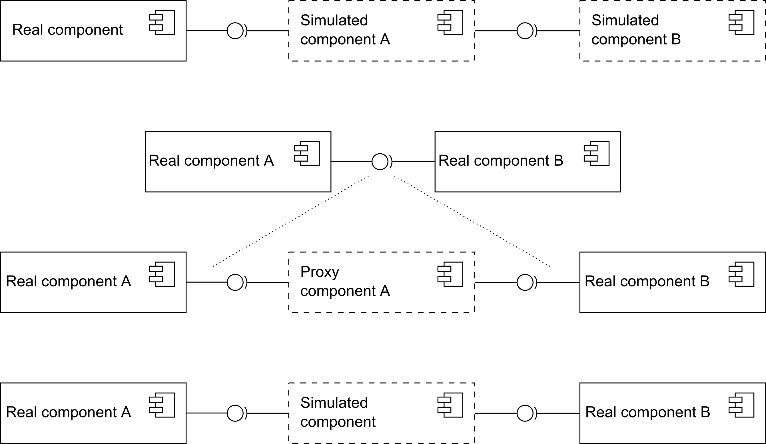
SimCo components – design problems
Notes:
The most complicated issue for using SimCo is implementation of simulated components. They have to be created for each component that should be replaced by its simulation and there is no simple way how to automate this process. Simulated components have to provide the same interface as the component they are replacing, but their internal behaviour depends on the intentions of designer of test. They can serve as simple oracles, returning precalculated values, or they can provide simplified functionality of real components, for example when the behaviour of component should follow a specific protocol. Simulated components can also perform measurements of tested components and log information about who and when used their services.
Implementation of proxy components is much easier and in current state of SimCo is semi automatic. Most of their functionality is the same in every case. Intermediate components are responsible mainly for logging of information about communication between real components and also for gaining control over timig of their communication.

Slide 8
Scenarios
Description of mandatory events
XML file, when and what happens
Regular / Casual / Rare
Settings of simulated components
XML file, depends on simulated component
Pre-calculated results
Settings of intermediate components
Properties of communication
Composition of the tested application
Which real and simulated components should be used
Notes:
The test of application is specified by a scenario. Each scenario contains several parts. At first, there are mandatory events, that has to happen in specified time. These events can for example simulate input of users. They can occure one time or they can repeat in regular or random intervals. Every event is call of specified service on component with specified parameters.
Another important part is settings of simulated component. Each simulated component can have attached XML file with properties, that should be used by simulation. These files are however proprietary for each simulated component – they depends on its implementation. They can for example provide precalculated values – responds for events in the simulation. Simulated component can be also implemented in the way that not require any further setting file. Settings of intermediate components serves similar purpose. The only reason for this settings so far is simulation of network communication (and settings of its properties, such as delays in network), in case that real components should be deployed on different devices.
The last setting file contains description of the whole simulated application – which real and simulated components are used, where the connections and proxy components are placed, where are time measuring probes and where the results should be stored.

Slide 9
Experiments – testing technologies
Java, OSGi, SpringDM
Testing application – file manager

Slide 10
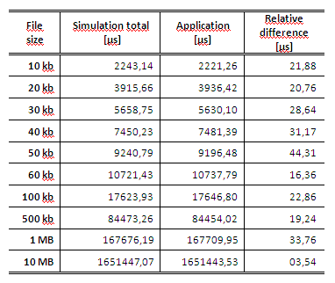
Experiments - overhead
Comparison of the time consumed by tested application and time measured by SimCo

Slide 11
Experiments - performance
Testing of performance of different implementations of one component
Displaying file in defined format
Constant and linear complexity

Slide 12
Experiments - performance

Slide 13
Experiments - communication
Measurements of data sent over a network device
Total ammount of transferred data
Count of messages sent and received
Analysis of transport and network layer headers
All messages correctly observed and delivered

Slide 14
Case study - Openmatics
Testing of car onboard software
Applications – „Boxlets“ as components, available from repository
Measurements of network communication
Speeding up of testing by replacement of original scheduler by its simulation

Slide 15
Future work
Solving problems with calls of Java API
Support for automated preparation of scenarios
Generating of basic simulated components
Based on analysis of use case specification
Comparison with static code analysis
Determining what type of errors can be discovered by simulation testing
Notes:
There are three main issues we are working on now. At first it is problem of uncnotrolled calls of Java API methods, that cannot ne described easily in a component way. They should provide components access to the network, to the file system or to the systém time without giving us chance to observe and adjust the results according to needs of the simulation.
Another thing is creating more case studies that woul allow us to work with other properties of components. In this example, we have focused on the correct functionality of the traffic control algorithm, but we also want to use SimCo to determine extra functional properties. We are working on a case study involving a component based file manager, that will allow testing of response of the component systém to users demands or behaviour of components that should follow specified protocol (such as FTP).
The last issue we are considering is comparison of our testing approach withc static code analysis. We want to determine which errors can be discovered by simulation tool and which can be discovered by static analysis of tested components. We also want to compare the scaling abilities of our tool in comparison with static analysis, in case that it can be used to the same class of errors.

Slide 16
Thank you for your attention

