Slide 1
Search in Source Code Based on Identifying Popular Fragments
Eduard Kuric and Mária Bieliková
{kuric,bielik}@fiit.stuba.sk
Faculty of Informatics and Information Technologies
Slovak University of Technology in Bratislava
SOFSEM 2013

Slide 2
Motivation
every day…
programmers need to answer several questions for the purpose of finding solutions and making decisions
structure of source code is not conducive to being read in a sequential style > programmers…
read code selectively
identify parts of code relevant to the target task
use the Web as a giant repository of source code
Notes:
Software development is one of the most creative things a human can do

Slide 3
Concept / feature location
process of identifying parts of source code that correspond to a specific functionality
input:
description of a problem (change task) expressed by concepts - terms, keywords
output:
a set of software components (artifacts) that implement or address the input concepts
Notes:
In literature, Search in Source Code is often termed by researchers as concept location
It is...

Slide 4
Why popularity?
to support search-driven development, it is not sufficient to implement a "mere" full text search over a base of source code
when a programmer reuses source code (from external sources) she has to trust the work of external programmers that are unknown to her
Notes:
Why do we need to establish popularity of software components?

Slide 5
Why popularity? /2
trustability (reputability) is a big issue for reusing source code (components)
reputation ranking
can be a plausible way to rank source code results
-> programmer’s “karma” value
Notes:
So if we are able to establish so called programmer’r “karma” value, then we can use it on reputation ranking

Slide 6
What we do?
modeling programmer’s knowledge
activity-based programmer’s knowledge model
methods for its automatic retrieving
Notes:
Our goal is to propose an …

Slide 7
How?
monitoring programmer’s interaction with source code
authorship
authorship duration
code stability
code patterns
work experience
used technologies
activities (selections, edits, search)
notability (popularity) of created components
Notes:
We monitor ...

Slide 8
Notability of created components
the more important a component is then a programmer has better knowledge about it
-> processing source code repository
-> searching for relevant functions for a given programmer’s query
Notes:
Identifying popular components is inspired by PageRank algorithm, where the “popularity” of a function is determined by how many functions call it.
Our proposed method consists of two phases, namely …

Slide 9
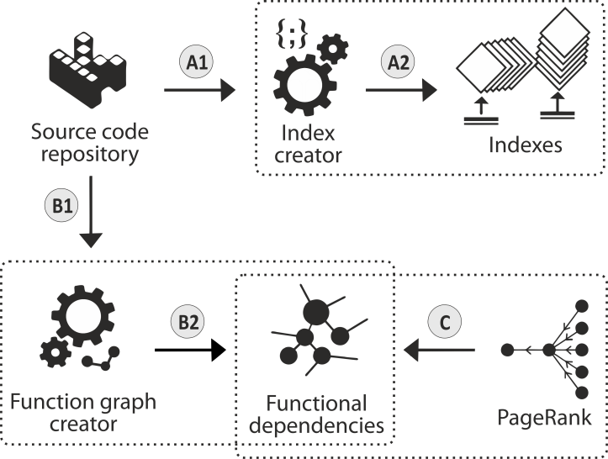
Processing source code repository
Notes:
Processing source code repository consists of index creator, function graph creator and pagerank calculation

Slide 10
Index creator
creates (document and term) indexes from all source code files of projects in the repository
uses Vector Space Model
terms are extracted from comments, names of functions and identifiers
Apache Cassandra

Slide 11
Processing source code repository

Slide 12
Function graph creator
creates a directed graph of functional dependencies
nodes represent functions names (full signature of functions)
directed edge from the function F to the function G is created if the function G is invoked in the function F
we use intermediate representation of source code, i.e., an abstract syntax tree (AST) and control flow graph (CFG) obtained from AST

Slide 13
Processing source code repository

Slide 14
Ranking functional dependencies
PageRank algorithm
rank value indicates importance of a particular function
functions called from many other functions, have a significantly higher PageRank value than those that are used infrequently

Slide 15
Processing source code repository

Slide 16
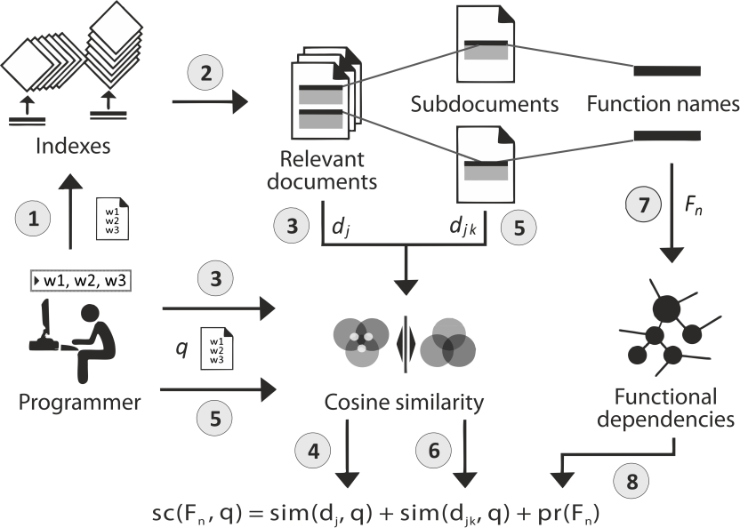
Searching for relevant functions
Notes:
Search consists of three main steps:

Slide 17
Phase#1
top relevant documents are retrieved based on a similarity sim(d_{j}, q) between documents (source code files) and programmer’s query q

Slide 18
Searching for relevant functions

Slide 19
Phase#2
each document d_{j} is divided into subdocuments, where each one contains only one definition of a function F_{n} contained in the “parent” document d_{j}
for each subdocument$d_{j_{k}}$, a similarity sim($d_{j_{k}}$, q) to the query q is calculated

Slide 20
Searching for relevant functions

Slide 21
Phase#3
finally, an ordered list of relevant functions is obtained so that, for each function F_{n} (F_{n}$∈ d_{j}$), a final score sc(F_{n}, q) is calculated as the sum of the similarities and a PageRank score pr(F_{n})

Slide 22
Searching for relevant functions

Slide 23
Evaluation
plugin into Microsoft Visual Studio
an experiment with 6 participants and 2 software projects (P1, P2)
how well the participants could find code fragments (functions) that matched given tasks
-> 2 groups (G1, G2) of 3 members
-> 2 experiments
Notes:
We implemented a plugin into Microsoft Visual Studio which allows programmers to formulate a query and the result is an ordered list of relevant code fragments
We conducted
Our goal was to evaluate
We divided the participants into
we performed

Slide 24
Experiment#1
a set of 6 change tasks - 3 tasks for each project
Find the method for calculating a co-occurrence rank of obtained annotation and change the damping factor to the value 0.3.
participants reformulated the target tasks into a sequence of words that described concepts they needed to find
Notes:
In the first experiment, we created

Slide 25
Experiment#1
T1: tasks 1-3 were specified for P1
T2: tasks 4-6 were specified for P2
the goal of G1 was to perform T1 using our search engine
the goal of G2 was to perform T1 using built-in search engine
G1 – T2 – built-in search engine
G2 – T2 – our search engine

Slide 26
Experiment#1
we compared the number of participants‘ queries created using our search engine and the built-in search engine
-> the participants had to make less effort for locating target code fragments (methods)
Notes:
We can see that by using our search engine

Slide 27
Experiment#2
we specified 2 implementation tasks T1, T2
participants of G1 were tasked to implement T1 using the built-in search engine
participants of G2 were tasked to implement T1 using our search engine
G1 – T2 – our search engine
G2 – T2 – built-in search engine
Notes:
We can see that by using our search engine

Slide 28
Experiment#2
for each query, each participant evaluated relevance of the results
for each obtained result , each participant assigned a level of confidence
completely/mostly irrelevant
mostly/highly relevant
fragments were evaluated as relevant only if they were ranked with the confidence levels mostly or highly relevant
Notes:
We can see that by using our search engine

Slide 29
Experiment#2
we used the precision metrics
it is the fraction of the top 5 ranked code fragments which are relevant to the query
Notes:
We can see that by using our search engine

Slide 30
Experiment#2
search results, obtained using our search engine, were more relevant during performing the tasks compared with the use of the built-in search engine
Notes:
The calculated average precision is shown in Table. It illustrates that

Slide 31
Why we do that?
PerConIK
focused on support of enterprise applications development by viewing a software system as a web of information artifacts
several agents collect and process documentations, source codes, developer blogs, developer activities, …

Slide 32
Why we do that?
we create a dataset based on monitoring complete behaviour of programmer
searching relevant information on the Web,
searching in source code,
writing and correcting source code in development environment
defining explicit feedback from the programmers for purpose of evaluation

