Slide 1
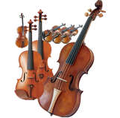
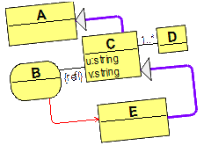
The Orchestra of
Multiple Model Repositories
Sergejs Kozlovičs
sergejs.kozlovics@lumii.lv
Research Laboratory of Modeling and Software Technologies
Institute of Mathematics and Computer Science, University of Latvia

Slide 2
The ``Orchestra'' Metaphor
Orchestra:
multiple musical instruments
playing simultaneously
Research Laboratory of Modeling and Software Technologies
Institute of Mathematics and Computer Science, University of Latvia
002

Slide 3
The ``Orchestra'' Metaphor
Orchestra:
multiple musical instruments
playing simultaneously
multiple model repositories
accessed simultaneously (inter-repository links are possible)
Research Laboratory of Modeling and Software Technologies
Institute of Mathematics and Computer Science, University of Latvia
002

Slide 4
The ``Orchestra'' Metaphor
Orchestra:
multiple musical instruments
playing simultaneously
multiple model repositories
accessed simultaneously (inter-repository links are possible)
Research Laboratory of Modeling and Software Technologies
Institute of Mathematics and Computer Science, University of Latvia
002

Slide 5
Meta-s
The "Gödel, Escher, Bach" book
by Douglas Hofstadter
* a publication
* a newspaper
* The San Francisco Chronicle
* the May 18 edition of the
The San Francisco Chronicle
* my copy of the May 18 edition of the
The San Francisco Chronicle * my copy of the May 18 edition of the
The San Francisco Chronicle as it was when
I first picked it up (as contrasted with my copy as it
was a few days later: in my fireplace, burning)
Research Laboratory of Modeling and Software Technologies
Institute of Mathematics and Computer Science, University of Latvia
002

Slide 6
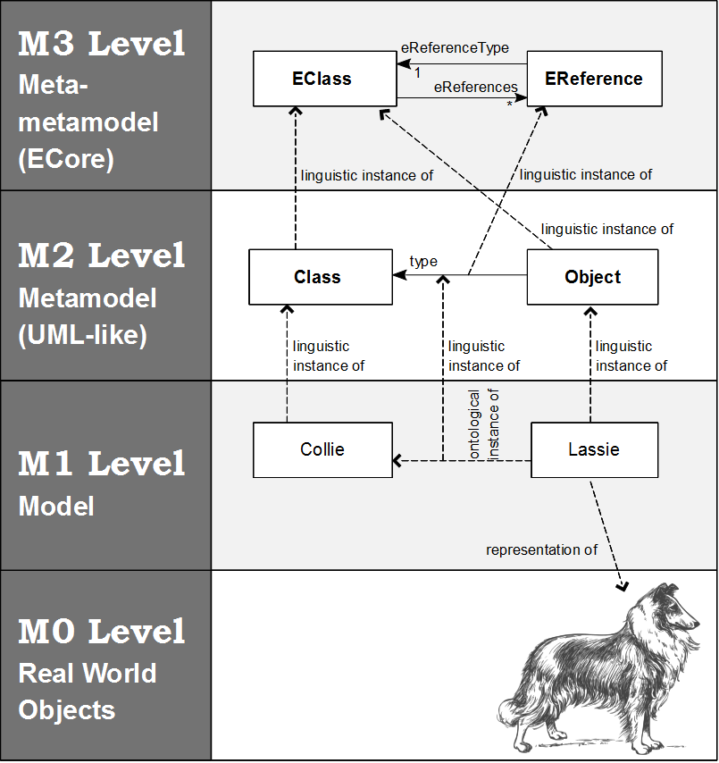
MOF Meta-Levels (Linguistic)
Research Laboratory of Modeling and Software Technologies
Institute of Mathematics and Computer Science, University of Latvia
002

Slide 7
The Three-Level Conjecture
(I. Kurtev and J. Bézivin)
Artifacts are organized into three layers:
the meta-metamodel;
metamodels conforming to the meta-metamodel;
models conforming to some particular metamodel.
Research Laboratory of Modeling and Software Technologies
Institute of Mathematics and Computer Science, University of Latvia
002

Slide 8
The Three-Level Conjecture
(I. Kurtev and J. Bézivin, 2005)
Artifacts are organized into three layers:
the meta-metamodel;
metamodels conforming to the meta-metamodel;
models conforming to some particular metamodel.
The meta-metamodel is able to describe itself.
Research Laboratory of Modeling and Software Technologies
Institute of Mathematics and Computer Science, University of Latvia
002

Slide 9
MOF Meta-Levels (Linguistic)
MOF
conforms to
conforms to
UML metamodel
conforms to
UML model
Research Laboratory of Modeling and Software Technologies
Institute of Mathematics and Computer Science, University of Latvia
002

Slide 10
Technical Spaces
(I. Kurtev, J. Bézivin, and M. Aksit; 2002, 2005)
MOF
OWL DL
DB system tables
conforms to
conforms to
conforms to
conforms to
conforms to
conforms to
UML metamodel
OWL classes
ER-model (DB schema)
conforms to
conforms to
conforms to
UML model
OWL individuals
DB rows
MOF TS
RDF/OWL TS
Relational DB TS
Research Laboratory of Modeling and Software Technologies
Institute of Mathematics and Computer Science, University of Latvia
002

Slide 11
Technical Spaces (cont.)
(I. Kurtev, J. Bézivin, and M. Aksit; 2002, 2005)
XML metaschema
(XSD.xsd)
BNF
conforms to
conforms to
conforms to
conforms to
XML schema
(.xsd)
Java grammar
conforms to
conforms to
XML document
Java program
XML TS
Grammarware TS
Research Laboratory of Modeling and Software Technologies
Institute of Mathematics and Computer Science, University of Latvia
002

Slide 12
Why different technical spaces?
One TS can be more suitable than another
Reusing skills and knowledge of a familiar TS
A capability not available in a desired TS can be borrowed from another TS
Research Laboratory of Modeling and Software Technologies
Institute of Mathematics and Computer Science, University of Latvia
002

Slide 13
TS interoperability
Offline solution: using projectors and extractors (B´ezivin et al.)
“Online” (On-the-fly) solution: this paper!
No deep copying of the data is required!
Research Laboratory of Modeling and Software Technologies
Institute of Mathematics and Computer Science, University of Latvia
002

Slide 14
Problem 1: Numerous different repositories
See Table 1 in the paper!
Research Laboratory of Modeling and Software Technologies
Institute of Mathematics and Computer Science, University of Latvia
002

Slide 15
Repositories
MOF TS:
EMF
CDO
MDR (NetBeans)
Enchanced Model Repository
MetaMart Metadata Repository
JR
...
See Table 1 in the paper!
Research Laboratory of Modeling and Software Technologies
Institute of Mathematics and Computer Science, University of Latvia
002

Slide 16
Repositories
The solution is a univeral Repository Access API, RAAPI
tda.lumii.lv/raapi.html
Research Laboratory of Modeling and Software Technologies
Institute of Mathematics and Computer Science, University of Latvia
002

Slide 17
Problem 2: Ontological meta-levels
Research Laboratory of Modeling and Software Technologies
Institute of Mathematics and Computer Science, University of Latvia
002

Slide 18
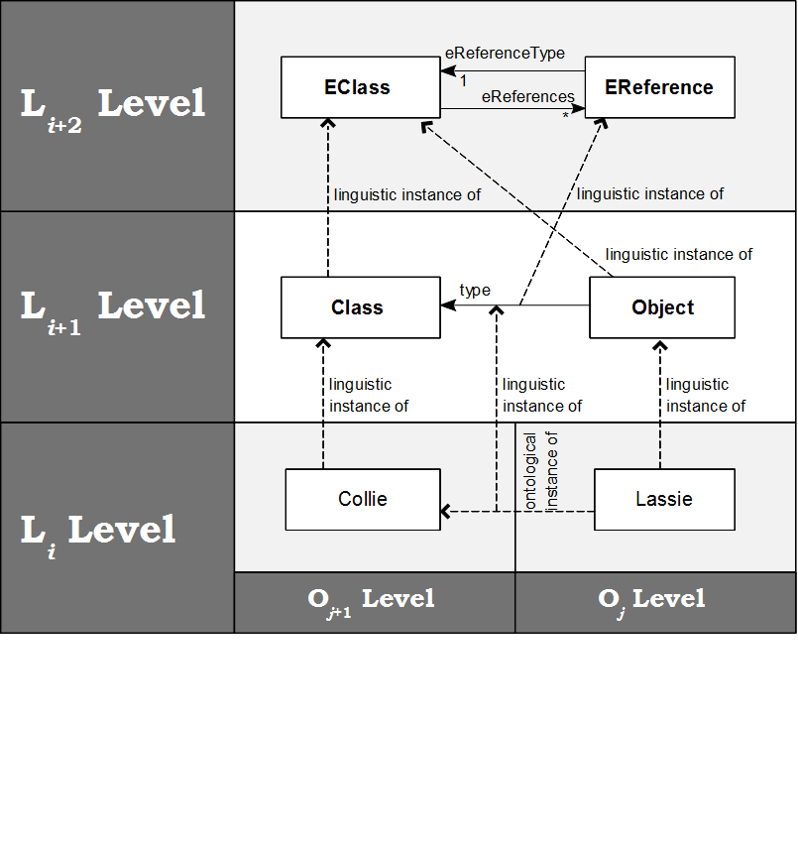
Ontological meta-levels
Research Laboratory of Modeling and Software Technologies
Institute of Mathematics and Computer Science, University of Latvia
002

Slide 19
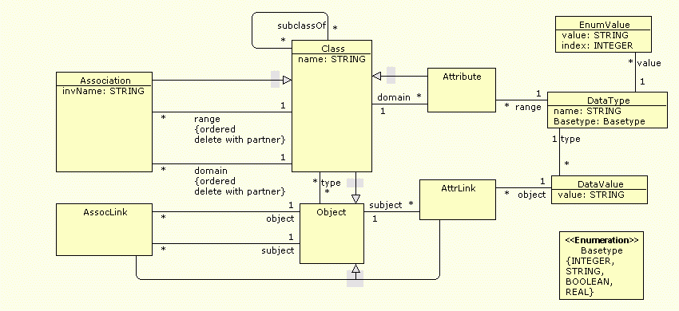
Meta-Levels (Ontological)
A meta-metamodel that supports infinitely many ontological meta-levels (used by the JR repository):
Research Laboratory of Modeling and Software Technologies
Institute of Mathematics and Computer Science, University of Latvia
002

Slide 20
Meta-Levels (Ontological)
A meta-metamodel that supports infinitely many ontological meta-levels (used by the JR repository):
Research Laboratory of Modeling and Software Technologies
Institute of Mathematics and Computer Science, University of Latvia
002

Slide 21
Meta-Levels (Ontological)
OWL Full also supports infinitely many ontological meta-levels.
Research Laboratory of Modeling and Software Technologies
Institute of Mathematics and Computer Science, University of Latvia
002

Slide 22
Shostaks' conjecture
It is difficult for a human to think at more than two meta-levels at a time.
Still, it is pretty easy for a human to focus on any two adjacent meta-levels.
Research Laboratory of Modeling and Software Technologies
Institute of Mathematics and Computer Science, University of Latvia
002

Slide 23
Shostaks' conjecture
It is difficult for a human to think at more than two meta-levels at a time.
Still, it is pretty easy for a human to focus on any two adjacent meta-levels.
Agris Šostaks
at SOFSEM 2012
Research Laboratory of Modeling and Software Technologies
Institute of Mathematics and Computer Science, University of Latvia
002

Slide 24
Dealing with Šostaks' conjecture
We divide the repository into two parts:
M3 contating the meta-metamodel;
fixed for a particular repository/technical space;
all other data (either M2+M1 or multiple ontological meta-levels)
Research Laboratory of Modeling and Software Technologies
Institute of Mathematics and Computer Science, University of Latvia
002

Slide 25
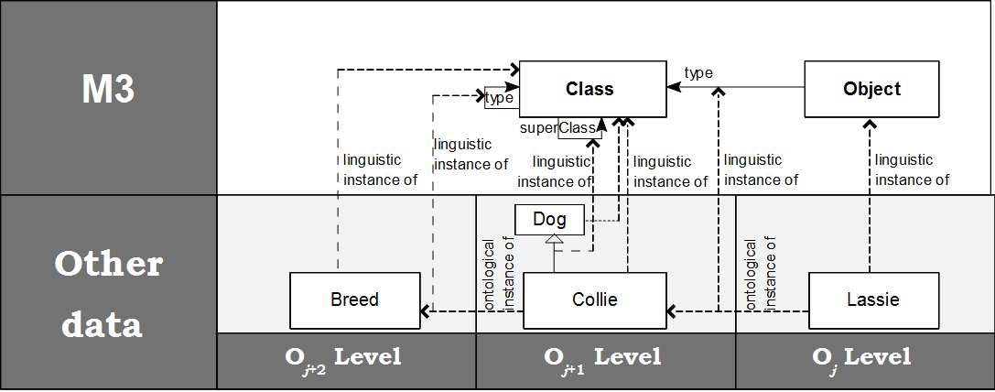
Dealing with Šostaks' conjecture
RAAPI is designed to work with any two adjacent meta-levels
Switching between levels and mixing them is possible by, e.g., passing a reference to a class when a reference to an object is expected.
Research Laboratory of Modeling and Software Technologies
Institute of Mathematics and Computer Science, University of Latvia
002

Slide 26
The Idea
The kernel represents all repositories as one big virtual repository.
The kernel substitutes native references (integers) of each repository by globally unique proxy references.
Inter-repository links are stored in the pivot repository.
Research Laboratory of Modeling and Software Technologies
Institute of Mathematics and Computer Science, University of Latvia
002

Slide 27
Kernel Metamodel (the essence)
Research Laboratory of Modeling and Software Technologies
Institute of Mathematics and Computer Science, University of Latvia
002

Slide 28
RAAPI call example: createLink()
createLink(obj1_ref, obj2_ref, association_ref);
If all proxy references point to the same repository, the call is forwarded to this repository.
Otherwise, an inter-repository link is created and stored in the pivot repository.
Research Laboratory of Modeling and Software Technologies
Institute of Mathematics and Computer Science, University of Latvia
002

Slide 29
Organizing repositories
Unix file system directory tree:
/boot
/bin
/mnt
/mnt/c
/mnt/d
/media
/media/cdrom
/etc
mount points
Research Laboratory of Modeling and Software Technologies
Institute of Mathematics and Computer Science, University of Latvia
002

Slide 30
Organizing repositories
Package tree (~ UML package tree):
Package1
Package2
Package2::SubPackage
Package3
Package4
Use “MountPoint::ClassName” to access a class in a mounted repository
mount points
Research Laboratory of Modeling and Software Technologies
Institute of Mathematics and Computer Science, University of Latvia
002

Slide 31
Organizing repositories
Root
package
Pivot
P1
P2
Research Laboratory of Modeling and Software Technologies
Institute of Mathematics and Computer Science, University of Latvia
002

Slide 32
Organizing repositories
Root
package
Pivot
P1
P2
SubP
New repository
Research Laboratory of Modeling and Software Technologies
Institute of Mathematics and Computer Science, University of Latvia
002

Slide 33
Problem 3:
Manipulating the packages
How to merge packages?
I.e., when working with class Package1::A, objects and properties of Package2::A are also taken into a consideration.
Research Laboratory of Modeling and Software Technologies
Institute of Mathematics and Computer Science, University of Latvia
002

Slide 34
Virtual repositories
Root
package
Pivot
P1
P2
SubP
Virtual repository
Relies on data from somewhere else (or, invents data)
Research Laboratory of Modeling and Software Technologies
Institute of Mathematics and Computer Science, University of Latvia
002

Slide 35
Virtual repositories
Root
package
Pivot
P1
P2
SubP
Virtual repository
Relies on data from somewhere else
Research Laboratory of Modeling and Software Technologies
Institute of Mathematics and Computer Science, University of Latvia
002

Slide 36
Virtual repositories
Root
package
Pivot
P1
P2
On-the-fly
model
transformation
SubP
Virtual repository
Relies on data from somewhere else
Research Laboratory of Modeling and Software Technologies
Institute of Mathematics and Computer Science, University of Latvia
002

Slide 37
Use cases for virtual repositories
Research Laboratory of Modeling and Software Technologies
Institute of Mathematics and Computer Science, University of Latvia
002

Slide 38
Views on metamodels
Root
package
Pivot
P1
P2
Base
metamodel
SubP
Virtual repository
View
Research Laboratory of Modeling and Software Technologies
Institute of Mathematics and Computer Science, University of Latvia
002

Slide 39
Volatile repository
Root
package
Pivot
Volatile
repository
P1
P2
SubP
Virtual repository
(stores its content
In RAM)
Research Laboratory of Modeling and Software Technologies
Institute of Mathematics and Computer Science, University of Latvia
002

Slide 40
Virtual merge
P
Q
Research Laboratory of Modeling and Software Technologies
Institute of Mathematics and Computer Science, University of Latvia
002

Slide 41
Virtual merge
P
Q
Virtual repository
implementing
“merge”
P
Research Laboratory of Modeling and Software Technologies
Institute of Mathematics and Computer Science, University of Latvia
002

Slide 42
Derived (calculated) associations and properties
A
B
Research Laboratory of Modeling and Software Technologies
Institute of Mathematics and Computer Science, University of Latvia
002

Slide 43
Derived (calculated) associations and properties
Virtual repository
computes
the association
A
B
A
B
Research Laboratory of Modeling and Software Technologies
Institute of Mathematics and Computer Science, University of Latvia
002

Slide 44
Derived (calculated) associations and properties
Virtual repository
computes
the association
A
B
A
B
merge
Finally, we just need to virtually merge these two packages!
Research Laboratory of Modeling and Software Technologies
Institute of Mathematics and Computer Science, University of Latvia
002

Slide 45
Virtual copy
P
Research Laboratory of Modeling and Software Technologies
Institute of Mathematics and Computer Science, University of Latvia
002

Slide 46
Virtual copy
P
P’
Virtual
repository
2
Virtual
repository
1
P
(old data)
Research Laboratory of Modeling and Software Technologies
Institute of Mathematics and Computer Science, University of Latvia
002

Slide 47
Virtual copy
Δ₂
Δ₁
P
P’
Virtual
repository
2
Virtual
repository
1
P
(old data)
Research Laboratory of Modeling and Software Technologies
Institute of Mathematics and Computer Science, University of Latvia
002

Slide 48
The Orchestra of
Multiple Model Repositories
Thank you! Děkuji!
sergejs.kozlovics@lumii.lv
Research Laboratory of Modeling and Software Technologies
Institute of Mathematics and Computer Science, University of Latvia
002

