Slide 1
Worst case analysis of non-local games
Andris Ambainis, Artūrs Bačkurs, Kaspars Balodis, Agnis Škuškovniks, Juris Smotrovs, Madars Virza
SOFSEM 2013
Špindlerův Mlýn
Česká republika
28.01.2013.
“COMPUTER SCIENCE APPLICATIONS
AND ITS RELATIONS TO QUANTUM PHYSICS”,
project of the European Social Fund
Nr. 2009/0216/1DP/1.1.1.2.0/09/APIA/VIAA/044
INVESTING IN YOUR FUTURE
Notes:
Typically, non-local games are studied in a framework where the referee
picks the inputs from a known probability distribution. We initiate the
study of non-local games in a worst-case study several non-local games
in this scenario.

Slide 2
Overview
Motivation
Some preliminaries
“Worst-case” equal to “Average-case”
“Worst-case” different from “Average-case”
Games without common data
Notes:
Just few words about the structure;

Slide 3
Motivation
Non-local games
Computer scientist’s way of looking at:
Local vs. Non-local;
Quantum vs. Classial;
“Worst-case” vs. “Average-case” (intro)
Worst-case and average-case complexity?
«Real life» problems
Crypograpy
Connection to input data
Notes:
Non-local games are obviously a game theory entity.
Non-local gemes give a model to study non-local efects vs local efects, that is it gives for computr scientist a familiar way to study effects of quantum phisics and compare it to classical one.
It all started with EPR-paradox paper and introduction of hidden variable thory. Einstein and his colegues introduced a model that explaind at that point unexplained phenomena of quantum phisycs.
Only after some time Bell introduced his famous inequalities, that (i am rephrasing) said that if a system is local (even with hidden variables) it must satisfy the inequality. But as it later was experimentaly shown quantum systems do not follow this inequality.
So non-local games describe this phenomena. Well known examples (that are also experimentaly realaizable) are the CHSH game and Mermin-Ardehali games.
The use of worst-case and average-case complexity is quite natural in computer science.
The worst-case situation for a system shows as at most what resources we need to get the result. For real life system that could be a pesimistic evaluation, as it could happen that practical cases or the most used ones do not fall in worst-case category. So it is natural to look at avarege-case situations.
Naturally there are algortihms which resurce usage is determined by structure of input data.
Also it should be noted that there are different expected results from complexity studies. In solving some task it is reqired that average-case resource usage is as low as posiible. But for example in cryptography it is essential that average-case is as close to worst-case as possible.
I will define worst-case and average case in game theory perspoective in a few slides.

Slide 4
Preliminaries - nonlocal games
π | P1 | P2
p₁ | 0 | 0
p₂ | 0 | 1
p₃ | 1 | 0
p₄ | 1 | 1
N cooperating players: A₁, A₂, ..., A_{N}
They try to maximize game value
Before the game the players may share a common source of correlated random data:
Classical model: common random variable
Quantum model: $|\left.ψ\right\rangle =𝒜_{1}⨂𝒜_{2}⨂…⨂𝒜_{N}$
Input: x = (x₁, x₂, ..., x_{N}); Probability distribution: π
Output: a = (a₁, a₂, ..., a_{N}); A_{i} → a_{i} In this talk: a_{i} ∈ {0; 1}
Winning condition: V(a | x)
Game value $ω$:
Notes:
Now more specific deffinition of non-local games.
We have n cooperating players that together try to maximize the game value - that is the winning probability. The players play against a referee. Players win as group there is no individual gains.
Before the game players are informed of what the game will be and allowed to agree on algorythm to use. After the begining of game they are not allowed to comunicate.
Each player is given some input xi by the referee. Referee uses some probability distribution pi to select one from all posible input strings. Then the players each generate an output, that coud deppend on input variable and some shared randomness available to them.
The referee then evaluates the input/data with some predefined functon. The result tells wether players won or lost.
There are two models that we consider one is classical – where players are allowed to share common random variable and use a random variable to randomize the strategies. (i.e. Classical here means random)
In the quantum game model – players each have a qubit of entangled quantum state. After recieving input each player measures the state in some basis and output the result given by measurement. Also players are allowed to use superpossition of game strategies.
Why are these models compareable – there is the no communication theorem that says that it is not possible to comunicate by measuring entangled qubits.
Here I will use notion of game value-omega. It represents the difference between wining and loosing probability. It is easy to go from wining probabiliy to game value and back.

Slide 5
Average and worst case scenarios
Maximum game value for fixed distribution π:
Classical:
Quantum:
In the most studied examples π is uniform distrubution
We will call it «average-case»
Maximum game value for any distribution: worst-case
Classical:
Quantum:
Notes:
I will use average-case and worst-case scenario to represent input bit distributions.
I will say that the scenario is average-case if the referee chooses input string form uniform distribution. This is the case in all the classically studied games. So to calculate the game value we just look at the best possible sum that players can get by choosing random strategies on some given input.
On the other hand – if the referee, knowing the strategy of players chooses the worst possible distribution of input strings, then it is the worst-case scenario.
To calculate game value – we need to look at the same thing and add a dimmension of different input string distributions-and look for the minimal one.
It follows naturally from the deffinition that worst-case game value is smaller or equal to fixed input distribution game value (also uniform).

Slide 6

CHSH game
Games with worst case equal to average case
x₂
Bob
x₁
a₂
Alice
Input: x₁, x₂ ∈{0,1}
Output: a₁, a₂ ∈{0,1}
Rules:
No communication after inputs received
Players win,
If given x₁=x₂=1, they output a₁⊕a₂=1
If given x₁=0 or x₂=0, they output a₁⊕a₂=0
With classical resources,
Pr[a₁⊕a₂ = x₁∧x₂] ≤ 0.75
But, with entangled quantum state |00⟩ – |11⟩
Pr[a₁⊕a₂ = x₁∧x₂] = cos²(π/8) = ½ + ¼√2 = 0.853…
a₁
Referee
x₁x₂ | a₁⊕a₂
00 | 0
01 | 0
10 | 0
11 | 1
${:ω}_{c}=$0.5
$${:ω}_{q}=\frac{1}{\sqrt{2}}$$
Notes:
This model shows that adding qunatum resources we can break results that are provably maximum in classical world.
We have 2 players –usually Alice and Bob who are together compeating against a referee.
As an input they get a classical bit in some state, each.
They have to output a single classical bit each – that meets some critteria that are dependant on input and output data.
In this case – the ouput must be such – that xoring output bits leads to zero, if at least one of input bits is 0, and xor is 1 if both inputs are 1.
One more thing – after the input is recieved – no comunication is possible between these two players.
(Let people think a little)
It is easy to see, that if we have a deterministic strategy then – it is not possible to satisfy all four variants of input using this one strategy.
But it is possible and easy to get a strategy that satisfys 3 out of 4 input possibilities. That leads to max. Achievable result of 75%.
For example – whatever the input players always answer 0. This leads xor being 0 on all input – and this satisfys 3 first input posibilities.
OK this is easy.
Where is the magic?
The magical thing is that if we give each player a qubit that are both entangled – the best probability of success is higher than 75%.
Ist equal to square of cosine of (pi/8) – and thats more than 75%.
And this difference is the one that is equivalent to Bell inequality and breaking it when using quantum model.

Slide 7
CHSH game: worst-case
Games with worst case equal to average case
Average-case:
Worst-case:
In quantum case the same result is achieved on every input.
This leads to worst-case game values:
x₁ x₂ | Correct Answer | a₁ a₂ | a₁⊕a₂ | Satisfy
00 | 0 | 0 0 | 0 | +
01 | 0 | 0 0 | 0 | +
10 | 0 | 0 0 | 0 | +
11 | 1 | 0 0 | 0 | -
p=.25
x₁ x₂ | Correct Answer | a₁=0 a₂=0 | ⊕ |  | a₁=0 a₂=x₂ | ⊕ |  | a₁=x₁ a₂=0 | ⊕ |  | a₁=x₁ a₂=! x₂ | ⊕
0 0 | 0 | 0 0 | 0 | + | 0 0 | 0 | + | 0 0 | 0 | + | 0 1 | 1 | -
0 1 | 0 | 0 0 | 0 | + | 0 1 | 1 | - | 0 0 | 0 | + | 0 0 | 0 | +
1 0 | 0 | 0 0 | 0 | + | 0 0 | 0 | + | 1 0 | 1 | - | 1 1 | 0 | +
1 1 | 1 | 0 0 | 0 | - | 0 1 | 1 | + | 1 0 | 1 | + | 1 0 | 1 | +
p1=?
p2=?
p3=?
p4=?
Notes:
This was the game that inspired our group to look at worst-case scenarious. Unfortunatly it gave quite simply acievable strategy, that gave the same worst case game value as in average case. Playerschoose four different strategies that each looses on a different input and then uniformly with probability ¼ choose one of them. They get the same probability of ¾ that is game value of 0.5.
As for quantum case – the result shown on the previous page is achieved on every input distribution so the quantum game valua also is the same – 1/sqrt(2).

Slide 8
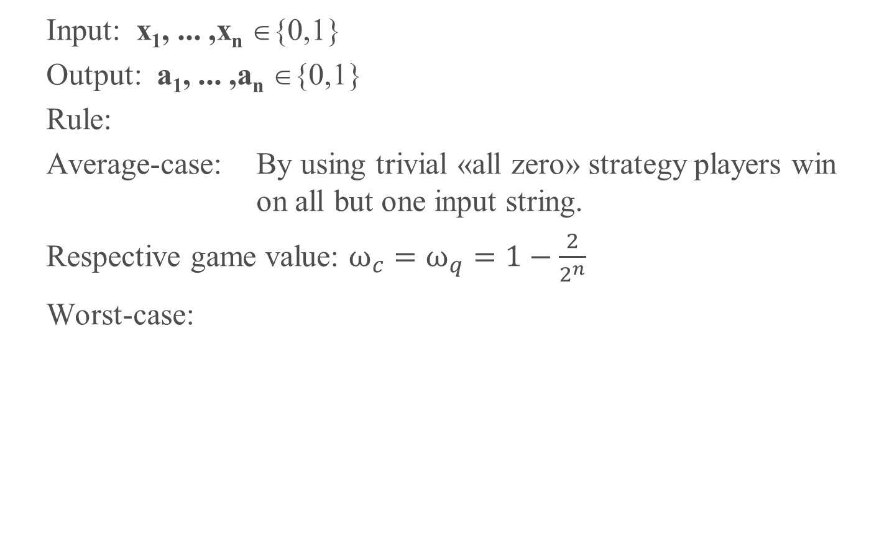
n-party AND (nAND) game
Games with worst case different from average case
x₁x₂...x_{n} | XOR
00...00 | 0
00...01 | 0
00...10 | 0
... | ...
11...10 | 0
11...11 | 1
Input: x₁, ... ,x_{n} ∈{0,1}
Output: a₁, ... ,a_{n} ∈{0,1}
Rule:
Average-case: By using trivial «all zero» strategy players win on all but one input string.
Respective game value: $ω_{c}=ω_{q}=1−\frac{2}{2^{n}}$
Worst-case:
Notes:
Lets look at CHSH game generalization for n-players.
We have n players that each recieve a bit and must output bits so that they xor to «1» only if they all get 1 as input. On all other inputs theyr outputs must xor to «0». In classical average case – players win on all but one of 2^n input strings.
Worst-case analysis is not that stright forward-as there is just one strategy that gives this big win probability. After deeper analysis we found out that for large n the game value coverges to 1/3.
We can see that the results are different.
The quantum case is not that interesting-we show that in average case the game value is the same as in classical. And after some optimization of Thirelsons theorem that has been simplified for symetric XOR games we get the same result in quantum case.

Slide 9
Equal-Equal (EE_{m}) game
Games with worst case different from average case
Input: x₁, x₂ ∈{1,...,m}
Output: a₁, a₂ ∈{1,...,m}
Rule:
Worst-case:
Worst-case quantum:
Average-case:
Notes:
Here is one more example. A generalization of odd-cycle game. There are two players, but now they get as an input a number from 1 to m and must output some number from the same set. Players win, if when they get equal bits as input-they output equal bits.
In average-case players win wit m-2 over m. Worst-case divides in odd/even..why????
TBD

Slide 10
Games without common data
For known fixed probability distribution:
«Not allowed to share common randomness»
equivalent to
«Allowed to share common randomness»
We just fix the best value for common randomness
In the worst-case:
For many games: unable to win with p>0.5
Consider a game:
Notes:
If the probability distribution is fixed (as it is in average-case scenario), the use of shared common randomness is not generally neccessary as the values can be fixed to ones that give the best probability.
In the worst-case scenarios it is not the case – the instrument that worked for players was to include shared randomness in their strategy to minimise the thret of referee choosing bad inputs. Without this common randomness-they cant coordinate their strategies so for many games players are unable to win with probability higher than ½
But there are games where this is not true. For example- 2 player game where players must both output 1 if at least one of them got 1 in input. And something else if input was 00.

Slide 11
Conclusion
We have introduced and studied worst-case scenarios for nonlocal games
We analyzed and compared game values of worst-case and average-case scenarios
Worst-case equal to average-case game value:
CHSH game
Mermin-Ardehali game
Odd cycle game
Magic square game
Worst-case not equal to average-case game value:
We introduce new games that have this property (by modifying classical ones)
Equal-Equal game
N-party AND game
N-party MAJORITY game

Slide 12
Thank you
I invite You to visit

