Slide 1
Theory of Multicore Hypervisor Verification
W. Paul
Saarland University
joint work with E. Cohen, S. Schmaltz….

Slide 2
What is a kernel ?
The Classic: Turing machine kernel
Simulating k one tape Turing machines by 1 one tape Turing machine
  Tracks: address translation
  Head position and state: process control block
  Round robin: scheduling
tape(1,left) s_1 tape(1,right)
tape(2,left) s_2 tape(2,right)
tape(3,left) s_3 tape(3,right)

Slide 3
What is an M-kernel ?
process virtualization:
  simulating k machines of type M by 1 one tape machine of type M
+ sytem calls
  for inter process communication…
M:
  MIPS, ARM, Power, x64…
tape(1,left) s_1 tape(1,right)
tape(2,left) s_2 tape(2,right)
tape(3,left) s_3 tape(3,right)

Slide 4
What is a hypervisor ?
guests can be operating systems, i.e. in system mode
2 levels of translation
  hypervisor page tables
  guest page tables
  ‚subdivide tracks‘
hardware support
  nested page tables
no hardware support:
  composition of translations is translation
  maintain ‚shadow page tables‘ (SPT) for combined translatio
  redirect memory management unit (mmu) to SPTs

Slide 5
Background
2007-2010: effort to formally verify MS HyperV
  part of German Verisoft-XT project (Paul, Broy, Podelski, Rybalchenko…), 13 Mio €
  MS Windows + Research (Cohen, Moskal, Leino,…)
We failed 2010
  tool development (VCC) successful
  crucial portions of code verified
  tool documentation and soundness argument less than perfect
  paper and pencil theory incomplete in 2010
We did not know (exactly enough) what to prove

Slide 6
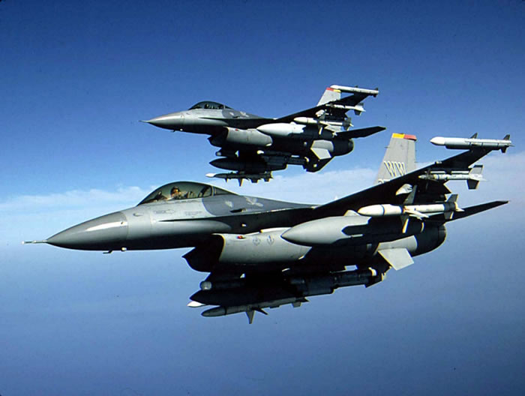

Hypervisor Correctness is either
One theorem in 1 theory
  then we are in weapons business of cycber war
or bug hunting
  then we (formal verification ehineers) are competing with the software community
  and may get beaten up

Slide 7
This talk
(only) 2 years after end of project
outlines
  model stack for multicore hypervisor verification
    I think complete
  simulation theorems between layers
  soundness of VCC and its use
size of remaining gaps:
    <= PhD thesis
    I supervised 59 so far

Slide 8
Three kinds of arguments
abstraction
  classical commutative diagrams
order construction
  in nondeterministic model of concurrent implementation
  from details of deterministic implementation
order reduction
  exclude w.l.o.g. interleavings in concurrent model

Slide 9
7 main theories (1)
multicore ISA-sp
  system programmers manual
  hardware correctness
serial ISA abstraction
  to ISA-u (for users)
serial language stack
  C + macro assembly + ISA-sp
  compilers + macroassemblers
  C+ ISA + devices
  drivers
  exception handlers
  boot
ownership in concurrent computation
  push through stack
  serial compiler translates parallel C

Slide 10
7 main theories (2)
Soundness of VCC and its use
  C + ghost + assertions
  VCC proofs imply ownership discipline
  use of C-verifier for C+ISA + devices
Hypervisor correctness
  virtual tread simulation (kernel layer)
  nested address transation (shadow page tables)
  ISA-sp virtualization

Slide 11
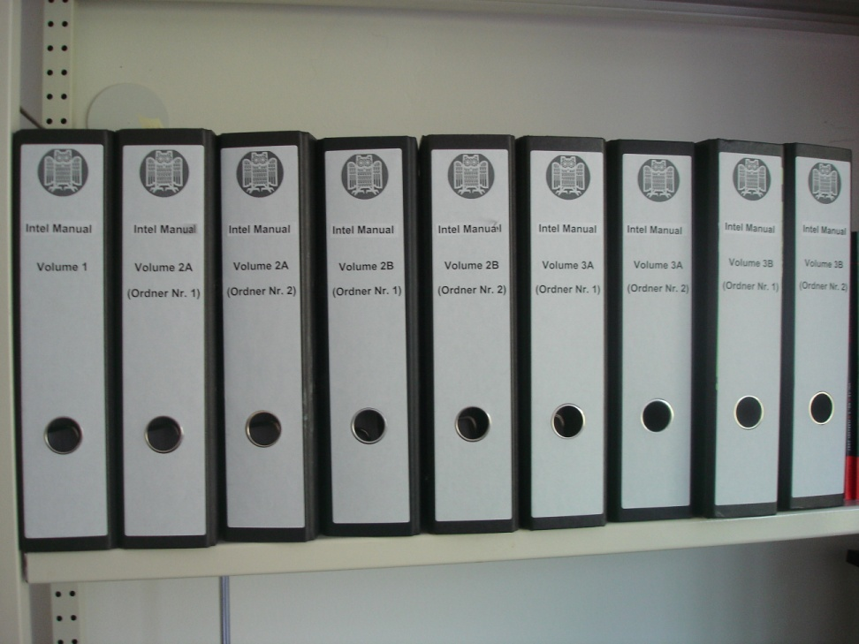
ISA-sp (1)
X64
  Intel: 3000 pages
  AMD 1500 pages
  Diss. Degenbaev 300 pages math
  http://rg-master.cs.uni-sb.de/publikationen/UD11.pdf
MIPS-86
  MIPS-ISA+ X86 memory model
  15 pages
  http://www-wjp.cs.uni-saarland.de/publikationen/SchmaltzMIPS.pdf

Slide 12
ISA-sp(2):
X64
disk
APIC
X64 ISA model
  E. Cohen: nondeterministic communicating sequential components
  sb: store buffer
  mmu: memory management unit
  APIC: device, interrupts
  disk: for booting
details subtle
  better reverse engineer MIPS-86 and prove
mem + caches
sb
mmu
core

Slide 13
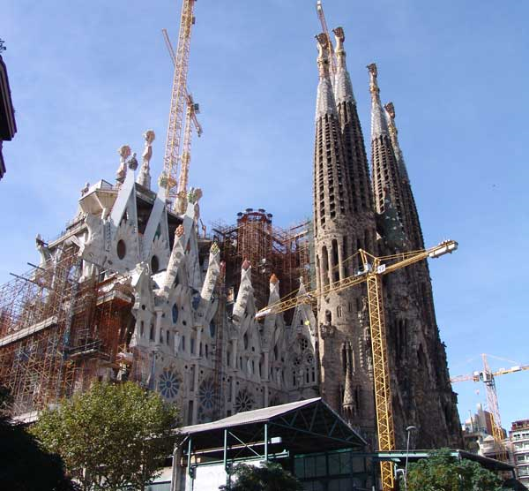
ISA-sp (3): MIPS-86 hardware correctness (formal/paper)
Processor correctness
  pipelined
  one memory mode: WB
  software conditions: alignment; no self modifying code
  digital gate level + gate delays
  sequentially consistent shared memory (MOESI)
April 4, 2012
  283 pages
  http://www-wjp.cs.uni-saarland.de/lehre/vorlesung/rechnerarchitektur2/ws1112/layouts/multicorebook.pdf
TODO
fetch and add (easy)
fences and sync (easy)
consistent memory modes (easy)
interrupts + devices (subtle)
MMU (subtle)
store buffers (easy)
Tomasulo scheduler (hard)

Slide 14
ISA-sp to ISA-u (1)
Caches invisible
  Use cacheable memory modes only
  compatibility of coherency protocols (MOESI +….)
  side remark in Smith & Plezkum
mem + caches
sb
mmu
core
sb: store buffer

Slide 15
ISA-sp to ISA-u (2)
caches invisible
sb invisible in single core
  easy folklore theorem
  proof: Degenbaev et al: Pervasive theory of memory 2009
  In Susanne Albers and Helmut Alt and Stefan Näher, editors, Efficient Algorithms -- Essays Dedicated to Kurt Mehlhorn on the Occasion of His 60th Birthday,Saarbrückenvolume 5760 of Lecture Notes in Computer Science, pages 74-98, Springer, 2009.
mem
sb
mmu
core
sb: store buffer
sb: store buffer

Slide 16
ISA-sp to ISA-u (3)
caches invisible
sb invisible
mmu invisible
  set up page table tree
  linear/translated memory
  easy folklore theorem
  proof: Degenbaev et al: Pervasive theory of memory 2009
mem
mmu
core
sb: store buffer

Slide 17
ISA-sp to ISA-u (4)
caches invisible
sb invisible
mmu invisible
ISA-u
mem
core

Slide 18
language stack (1)
C+macro assembly + assembly+ISA-sp
C small steps semantics (interleave in parallel C)
C+ macro assembly realistic and close to VCC
uses stack abstraction
process save and restore handles stack pointers
invisible in C + macroassembly
C
compiler
m-asm
m-assembler
ISA-u=asm
before
ISA-sp

Slide 19
language stack (2) combined language semantics

Slide 20
language stack (3) compilation
Optimizing C compiler:
  Xavier Leroy. Formal verification of a realistic compiler. C ACM, 52(7):107-115, 2009.
Optimizing C Compiler + macro assembler + assembler
  C calls m-asm and vice versa
  function pointers
  Paper theory: Diss Shadrin. http://www-wjp.cs.uni-saarland.de/publikationen/Sh12.pdf
  Schmaltz and Shadrin: VSTTE 2012
  Paul et al: SEFM 2012

Slide 21
MIPS ISA-u +devices (1) formal hardware correctness
  Hardware truely parallel, processor pipelined
  ISA nondeterministic concurrent, 1 step at a time
  construct order of steps
  Diss Tverdychev, http://www-wjp.cs.uni-saarland.de/publikationen/Tv09.pdf
  hardware complex due to a detail in ISA for external interrupts that we used
  ‚continue‘ instead of ‚repeat‘ as in X86
dev 1
proc
dev k

Slide 22
MIPS ISA-u + devices (2) formal (C+assembly)- driver correctness
  disable and don‘t poll interrupts of devices >1
  reorder their device steps out of driver run of dev 1
  pre and post conditions for drivers…
Diss. Alkassar
  http://scidok.sulb.uni-saarland.de/volltexte/2009/2420/pdf/Dissertation_1410_Alka_Eyad_2009.pdf
Alkassar et al: TACAS 08
dev 1
proc
dev k

Slide 23
MIPS ISA-u + devices (3) startup
  Hypervisor:
    disk: boot loader
    APIC: wake up other cores
    Diss Pentchev 2013?
  secure boot:
    digital signatures
    Verisoft (2003-2007)
dev 1
proc
dev k

Slide 24
Ownership (1) concept
Classify addresses
  local (e.g. C stack)
  shared and read only (e.g. program)
  shared owned (temporarily local/locked)
  shared writeable not owned (locks)
invariants:
  at most 1 owner ….
  disjointness…
safe programs: act like names of address classes suggest
accesses to class 4 atomic at the language level

Slide 25
Ownership (2)
Def: structured parallel C (folklore)
Classify addresses
  local (e.g. C stack)
  shared and read only (e.g. program)
  shared owned (temporarily local/locked)
  shared writeable not owned (locks)
multiple C threads
sequentially consistent memory
shared: heap + global variables
local: stacks
safe w.r.t. ownership
  class 4 access: volatile

Slide 26
Ownership (3) structured parallel C to parallel assembly
IF
  translate threads with sequential compiler
  translate volatile C access to interlocked ISA-u access
THEN
  ISA program safe
  multicore ISA-u simulates parallel C
A. Appel, X. Leroy et al: formal work in progress
  no store buffers
Dissertation C. Baumann 2012: pushing this through entire language hierarchy on paper

Slide 27
Ownership (4) parallel store buffer reduction in ISA-sp
dirty
maintain local dirty bits
  class 4 write since last local sb- flush
class 4 read only if dirty =0
Cohen Schirmer ITP 2010: store buffers invisible
  formal
  no mmu
to be pushed through hierarchy
  implement sb-flush as compiler intrinsic in C
C
compiler
m-asm
m-assembler
ISA-u=asm
before
ISA-sp

Slide 28
Ownership (5) semantics from hell
hyperV
dirty
Def: VCC-C:
  structured parallel C
  with Cohen Schirmer dirty bits
VCC-C + m-asm + asm +ISA-sp
C
compiler
m-asm
m-assembler
ISA-u=asm
before
ISA-sp
guest

Slide 29
Ownership (5) semantics from hell
hyperV
dirty
VCC-C:
  structured parallel C
  with Cohen Schirmer dirty bits
VCC-C + m-asm + asm +ISA-sp
  shared shadow page tables
  MMU (ISA-sp) walks SPTs (volatile C data structure)
  order reduction: interleave MMU steps at volatile C accesses to SPTs
C
compiler
m-asm
m-assembler
ISA-u=asm
before
ISA-sp
guest

Slide 30
Model stack
VCC-C +…+ISA.sp
compilation
(2-5)
ISA-sp
hardware correctness
(1)
digital hardware
timing analysis
(1)
gates+ regs.+drivers + delay

Slide 31
model and theory stack
hyperV
correct
soundness
TODO
Soundness of VCC and ist use
  VCC is parallel C verifier
Theorem: hyperV virtualizes multiple ISA-sp (+ system calls)
(7)
(6)
VCC-C +…+ISA.sp
compilation
(2-5)
ISA-sp
hardware correctness
(1)
digital hardware
timing analysis
(1)
gates+ regs.+drivers + delay

Slide 32
VCC (1) soundness: arguing about ownership
C + ghost: Dissertation Schmaltz 2012
  semantics
  simulation of C by C+ghost
  ghost code must terminate
  VCC-C + ghost
TODO for VCC soundness
  Semantics of assertion language of C + ghost (logics)
  show that assertions generated by VCC imply ownership + Cohen Schirmer dirty bit discipline
  soundness of verification condition generator used for serial and parallel langue constructs

Slide 33
VCC (2) use for C + m-assembly +ISA-sp
Dissertation Maus (Podelski)
  hybrid C variables, located in memory outside of regular C variables
  code non C portions of ISA-sp in hybrid variables
  write obvious C simulator
  translate m-assembly macros into C function calls in the naive way
wildly productive
  14K LOC verified
Maus et al: AMAST 2008
soundness:
  Dissertation Shadrin
  Paul et al: SEFM 12

Slide 34
HyperV correctness (1) kernel layer: many threads
Simulation of K C+masm + ISA-sp threads by k physical ISA-sp threads
  compile C part
  thread control blocks
  saving and restoring stack and heap pointers
  C + masm + asm
  APICs hard to simulate
similar to kernel correctness from Verisoft-1 Project (14 Mio €)
  paper: Gargano et al: TPHOLs 2005
  formal: Alkassar et al, VSTTE 2010
Dissertation Alekhin 2013?

Slide 35
HyperV correctness (2) shadow page tables
2 translations
  guest-OS to user
  host to guest - OS
with hardware support
  nested page tables
  no formal model and hardware construction yet
without harware support
  composition of translations is translation
  SPT for composition
  Redirect MMU to SPTs
SPT-algorithm without sharing beween processors, formal
  Dissertation Kovalev 2012
  Alkassar et al FMCAD 2010
in MS product SPTs with sharing

Slide 36
HyperV correctness(3)
ISA-sp virtualization and system calls
Virtualization
  with kernel layer and SPTs similar to Verisoft-1
  new: state of ISA-sp components of sleeping virtual procesors
  sb empty
  caches from hardware
  tlb empty or tagged as in hardware
Simple Hypervisor
  formal in VCC
  without save/restore: Alkassar et al: VSTTE 10
  with: Paul et al: SEFM 12
system calls and C data strutures of kernel as in formal work
  seL4 (only C portion but can extend with Verisoft-1 technology)
  or Diss Dörrenbächer 2010 http://www-wjp.cs.uni-saarland.de/publikationen/JD10.pdf
  or Diss M. Schmidt 2011http://www-wjp.cs.uni-saarland.de/publikationen/MS11.pdf (part of Verisoft automotive subproject. Broy-Paul)

Slide 37
Final remark
Paul VSTTE 2005
  a formal proof is an engineering object
  a paper proof is a building plan
IFIP working group on verified software 2012
  lack of such building plans recognized as major obstcle for development of formally verified systems
very difficult to publish so far ☺
Thank You

