Slide 1
Components in Computer Assisted Living?
František Plášil
Tomáš Bureš
bures@d3s.mff.cuni.cz
Partially supported by the EU project ASCENS 257414

Slide 2
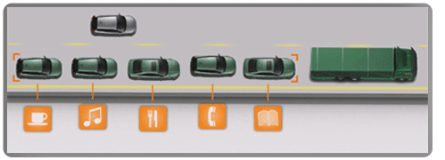
Context
Example: Road Trains
[FP7 project SARTRE]
Application Contexts in General
… Smart phones and on-body systems to communicate in changing and mobile environments that offer users access to information and services while on the move;
Homes, cars and offices, that offer systems and solutions for improved enjoyment, comfort, wellbeing and safety ...
Adapted from [ARTEMIS AWP 2012]
Notes:
iDNES.cz - 8.6.2012
http://auto.idnes.cz/autovlak-kde-je-ridic-nanic-vyjel-do-provozu-fmp-/automoto.aspx?c=A120607_183606_automoto_fdv
“Autovlak, kde můžete za volantem číst noviny, už vyjel”
iDNES.cz – 25.12.2012
Wi-fi v autech odhalí chodce a zajistí synchronizaci s počítačem
iDNES.cz -10.1.2013
VIDEO: Nová Škoda Octavia vykrouží zatáčku sama, řidič netřeba

Slide 3
Priorities (EU FP7 ICT)
FP7 ICT challenges:
Pervasive and trusted network and service infrastructures
Internet of Things, Internet of Services
Cognitive systems and robotics
Alternative paths to (hardware) components and systems
Technologies for digital content and languages
ICT for health, ageing well, inclusion and governance
ICT for a lower carbon economy
ICT for the enterprise and manufacturing
ICT for learning and access to cultural resources
[FP7 ICT WP 2013]

Slide 4
Goal of the Talk
Do we know how to develop such systems (for “computer assisted living”)?
In particular judging from perspective of component-based software engineering
System realization using components
Design process
Resume
Classical methods do not scale
There are new alternative approaches which scale better
Component ensembles, Invariant-based design process

Slide 5
Structure of the Talk
Case-studies
Realization using components
Classical approaches
Ensembles of components
Design process
Classical approaches
Invariant-based approaches

Slide 6
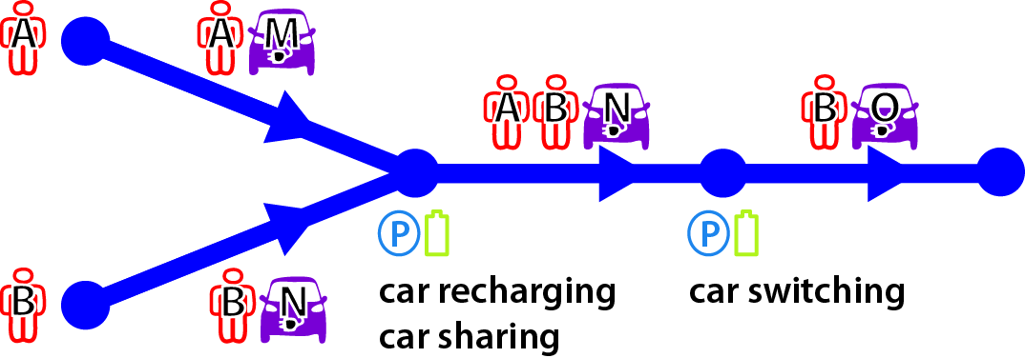
Example: E-mobility
ASCENS EU project (FP7 IP FET)
Goal: Self-aware, self-adaptive systems from components
Partners: LMU, Fraunhofer, VW, EPFL, VERIMAG, UNIPI, UDF, CUNI, UL, IMT, UNIMORE, ULB, Zimory, Mobsya, ISTI, CNRS, INPG
[FP7 project ASCENS – Deliverable D7.1 (VW Demonstrator)]
(Physical world)
Key Aspects
Open-ended
Dynamic
Autonomous
Adaptive
Emergent behavior

Slide 7
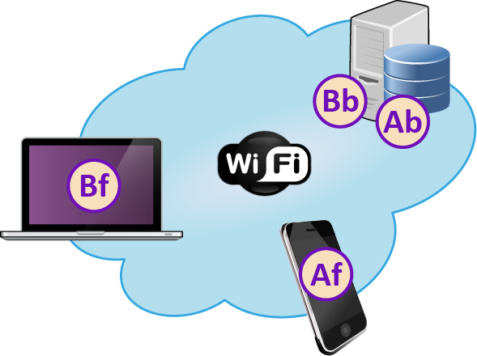
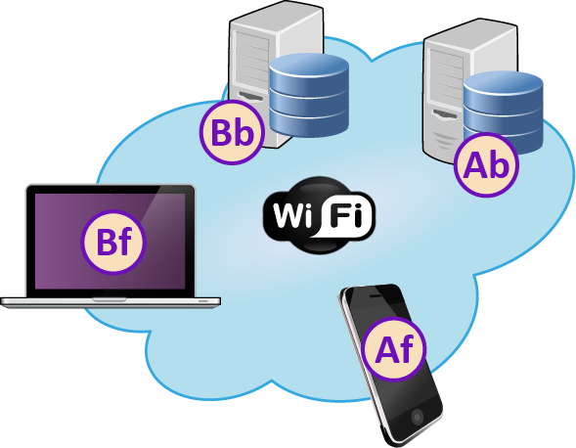
Example: Cloud computing
2
1
[FP7 project ASCENS – WP7.2 Demonstrator]
(Virtual world)
Key Aspects
Open-ended
Dynamic
Autonomous
Adaptive
Emergent behavior

Slide 8
Software Which Adapts to Environment
Component architecture has to constantly change to reflect the situation in the outer world
e.g. a new car appears in the world
e.g. a new passenger sharing a car

Slide 9
Realization via Components: Classical Approaches
Why don’t they scale …

Slide 10
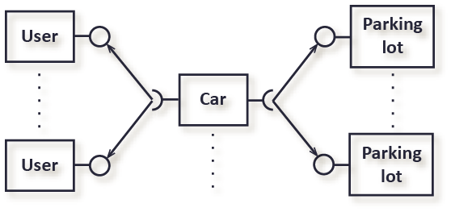
Classical Component-Based Approach
Centralized ownership & deployment
Cannot capture dynamic changes in architecture
Guaranteed communication needed
Strong reliance on other components

Slide 11
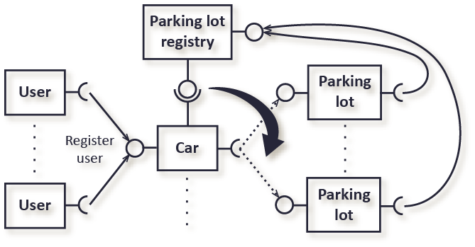
Service-Oriented Approach
3-rd party ownership & deployment
Dynamic architecture (via service-driven discovery)
Guaranteed communication needed
Strong reliance on other services

Slide 12
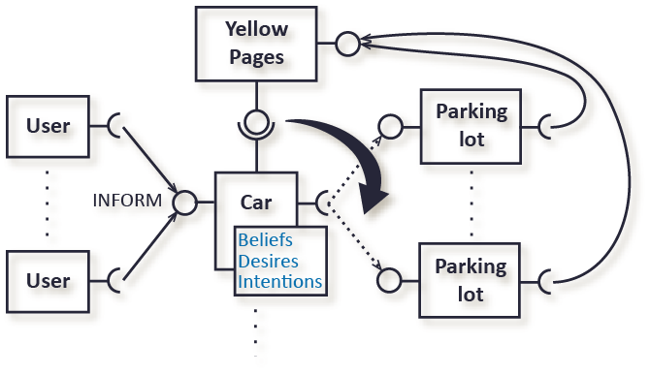
Agent-Based Approach
3-rd party ownership & deployment
Dynamic architecture (via agent-driven discovery)
Guaranteed communication needed
Autonomous (beliefs – desires – intentions)
Agents bring conceptual autonomy
But do not sufficiently translate it to proper software engineering constructs
Notes:
Beliefs: Beliefs represent the informational state of the agent, in other words its beliefs about the world (including itself and other agents). Beliefs can also include inference rules, allowing forward chaining to lead to new beliefs. Using the term belief rather than knowledge recognizes that what an agent believes may not necessarily be true (and in fact may change in the future).
Beliefset: Beliefs are stored in database (sometimes called a belief base or a belief set), although that is an implementation decision.
Desires: Desires represent the motivational state of the agent. They represent objectives or situations that the agent would like to accomplish or bring about. Examples of desires might be: find the best price, go to the party or become rich.
Goals: A goal is a desire that has been adopted for active pursuit by the agent. Usage of the term goals adds the further restriction that the set of active desires must be consistent. For example, one should not have concurrent goals to go to a party and to stay at home – even though they could both be desirable.
Intentions: Intentions represent the deliberative state of the agent – what the agent has chosen to do. Intentions are desires to which the agent has to some extent committed. In implemented systems, this means the agent has begun executing a plan.
Plans: Plans are sequences of actions (recipes or knowledge areas) that an agent can perform to achieve one or more of its intentions. Plans may include other plans: my plan to go for a drive may include a plan to find my car keys. This reflects that in Bratman's model, plans are initially only partially conceived, with details being filled in as they progress.
Events: These are triggers for reactive activity by the agent. An event may update beliefs, trigger plans or modify goals. Events may be generated externally and received by sensors or integrated systems. Additionally, events may be generated internally to trigger decoupled updates or plans of activity.

Slide 13
Realization via Components: Component Ensembles
What they are …
Why do they scale better …

Slide 14
Component Ensembles
Featured by ASCENS project
Stem from coordination languages KLAIM, SCEL
Implicit architecture (DEECo component model)
Described by interaction templates
When to communicate
What to communicate
Communication: data sharing
Asynchronous … belief
Scope: rapid dynamism, non-guaranteed communication
Easier development,
Apps more robust

Slide 15
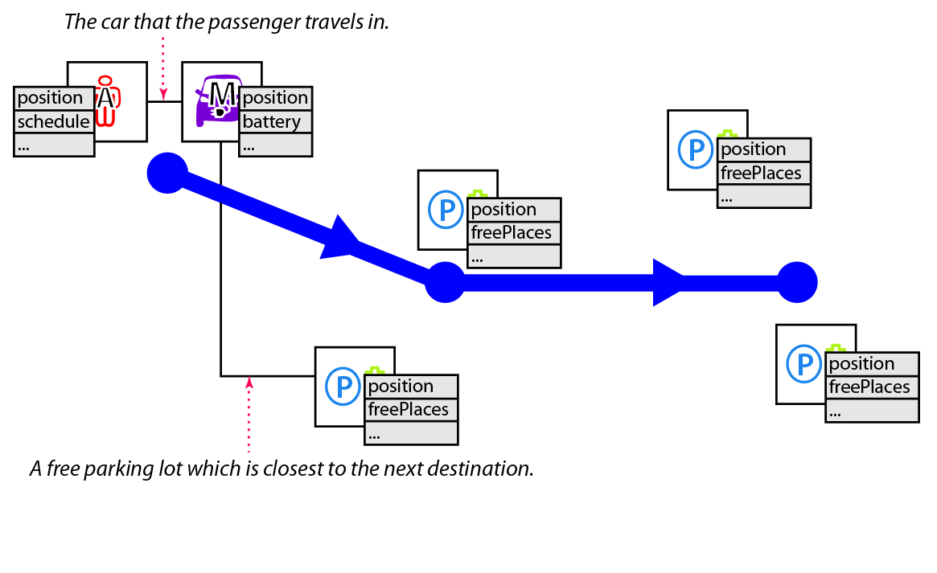
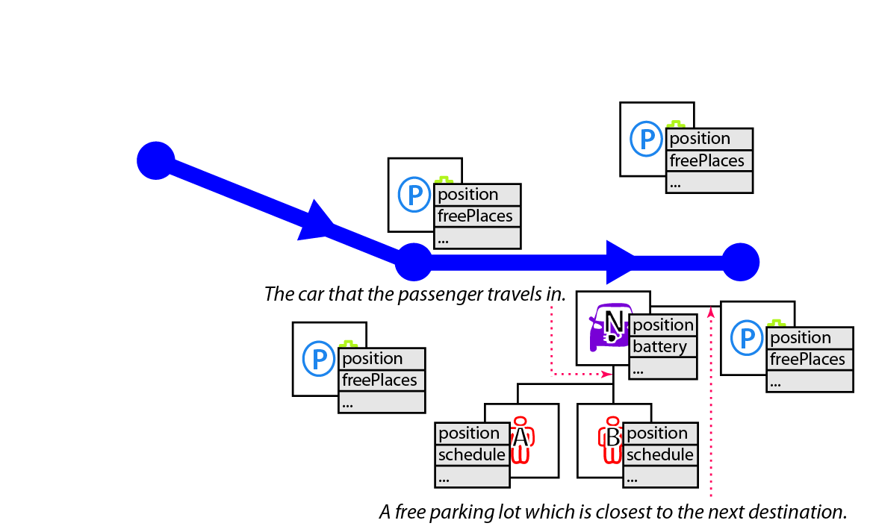
E-Mobility Case Study
[Volkswagen & Charles University]

Slide 16
E-Mobility Case Study
[Volkswagen & Charles University]
Component Vehicle = {
id: Id=”V1”
position: IPosition
availablePLCS: IPLCS
userSchedule: ISchedule
currentPlan: IPlan
…
process updatePlan {
function = updatePlan
inputKnowledge = [position,
availablePLCS, userSchedule, …]
outputKnowledge = [currentPlan, …]
scheduling = periodic(1s)
} }
Component PLCS = {
id: Id=”PL1”
freePlaces: Int
position: Iposition
bookings: Map[Id, IBooking]
…}
Interface IPLCS={
id: Id
freePlaces: Int
position: IPosition
}
Ensemble PLCSDiscoveryEnsemble{
member: IVehicle
coordinator: IPLCS
membership =
proximity(m.position, c.position) <= DIST_THR &&
m.freePlaces >= FREE_PLACES_THR
minimize proximity(m.position, c.position)
m->c mapping {
c.availablePLCS = c
}
}

Slide 17
E-Mobility Case Study
[Volkswagen & Charles University]
Prototype of the demonstrator
Video …
Developed in jDEECo
http://github.com/d3scomp/JDEECo

Slide 18
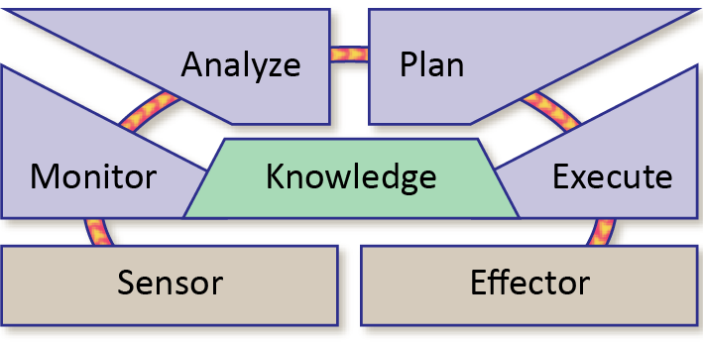
Component Ensembles
Can be seen as a system of conditionally interacting MAPE-K loops
MAPE-K Loop
Central concept of autonomic computing
Introduced by IBM

Slide 19
Component Ensembles – Summary
3-rd party ownership & deployment
Dynamic architecture
framework does discovery, transparent to component
Rapid dynamism & non-guaranteed communication
Autonomous (beliefs – desires – intentions)
What about component abstractions?
Ensapsulation a component can’t access another one
Substitutability knowledge forms the interface (semantics)
Reusability architecture externalized to ensembles

Slide 20
Design process

Slide 21
Design Process
Problem:
Component ensembles have relatively exotic computational model
Very far from classical procedure call-based sequential programming
Method for high-level design are necessary
Requirements … Components + Ensembles

Slide 22
Detour: Resilient Systems
“A resilient control system is one that maintains state awareness and an accepted level of operational normalcy in response to disturbances, including threats of an unexpected and malicious nature”
[wikipedia]

Slide 23
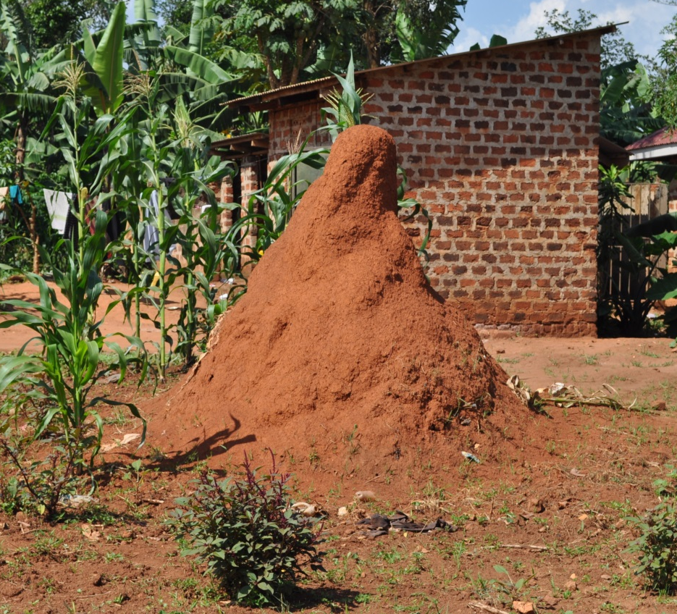
Resilience
System adaptability
System evolvability
Impact on external environment
Cooperative aspects
Notes:
http://en.wikipedia.org/wiki/Ant
Aphids and other hemipteran insects secrete a sweet liquid called honeydew, when they feed on plant sap. The sugars in honeydew are a high-energy food source, which many ant species collect.^{[117]} In some cases, the aphids secrete the honeydew in response to ants tapping them with their antennae. The ants in turn keep predators away from the aphids and will move them from one feeding location to another. When migrating to a new area, many colonies will take the aphids with them, to ensure a continued supply of honeydew. Ants also tend mealybugs to harvest their honeydew. Mealybugs may become a serious pest of pineapples if ants are present to protect mealybugs from their natural enemies.

Slide 24
Design of Resilient Systems with Classical SE Approaches
Why don’t they scale …

Slide 25
Classical Approaches
Use-cases, User stories, …
Use-case Example
Schedule meeting
User enters the possible dates of the meeting
Use enters e-mails of the participants
System validates the e-mail addresses
System sends an e-mail with an invitation to each participant
System confirms e-mails being sent
…
Problem?
Describes “how” instead of “what”.
Inherently less adaptable/evolvable.

Slide 26
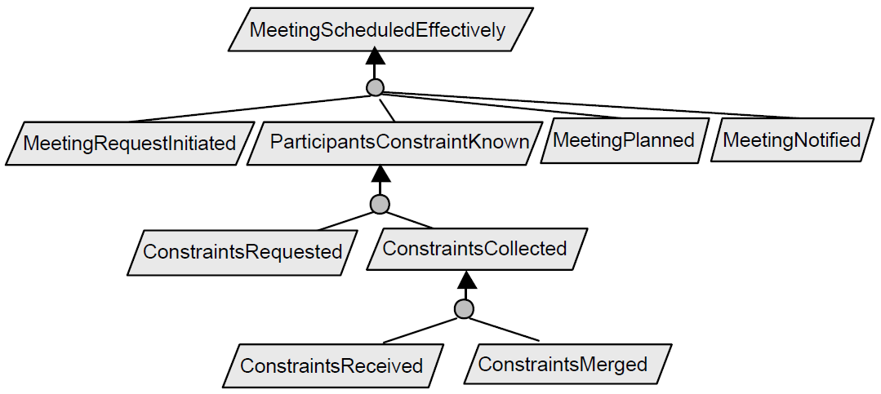
KAOS Model – System Goals
Problem?
Describes what is to be achieved, does not speak about the present moment.
“In what relation is the system to its environment and to itself right now?”

Slide 27
Promising directions?
What is promising to scale better …

Slide 28
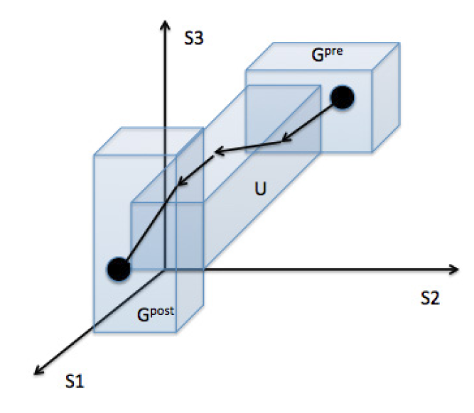
SOTA Model

Slide 29
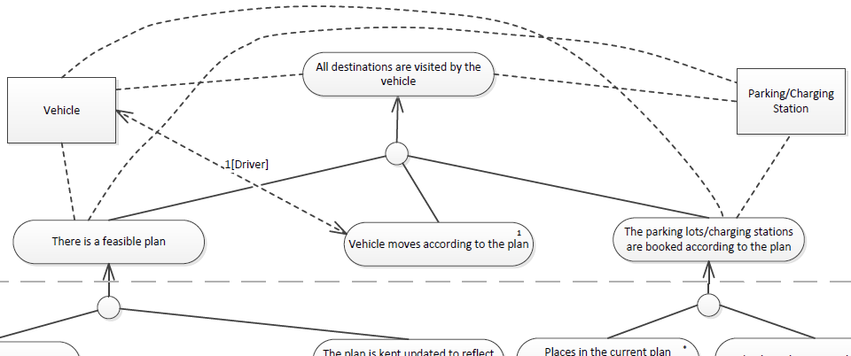
Predicate Refinement Model

Slide 30
Challenges: Different Levels of Abstraction
High-level of abstraction ~ describe goal
Low-level of abstraction ~ results of processes, ensembles
Non-crisp semantics
Predicates do not have to hold “always”
Predicates do not have to hold “completely”
New types of logic need:
Relaxes the system requirements ~ better efficiency
Hints the system of “closest” acceptable state

Slide 31
Conclusion

Slide 32
Conclusion: Where Do We Stand?
Mature methods for:
modeling relatively static systems by components, services
distributed algorithms using agents
closed distributed soft-realtime systems
analysis of such static systems
e.g. timing analysis, functional properties, …
goal-oriented design processes

Slide 33
Conclusion: What Do We Need?
New methods for:
development (using components) of distributed autonomous systems with emergent behavior
e.g. intelligent navigation in e-mobility, adaptive scaling in ad-hoc clouds
design process of autonomous systems
based on describing the expected state down to the level of components / ensembles

Slide 34
Roadmap – Short Term Priorities
We need to elaborate more on
Component self-awareness and adaptation based on high-level goals and strategies
Techniques and models with a proper level of abstraction for feasible testing and verification of correctness of components with emergent behavior
Prediction and optimization techniques for achieving efficient use of resources by distributed adaptive components
Security aspects

Slide 35
Summary
Components in Computer Assisted Living?
From software perspective – we are not very far and many things can be done already, we have to
combine existing approaches;
scale existing approaches and elaborate on new ones to address the large open systems with emergent behavior;
focus on how to employ the existing techniques in software engineering

